Slide 1

Bootcamp on AI for Cybersecurity
Bootcamp
Narendra Singh (PhD Scholar)
Department of computer Science Indian Institute of technology, Patna

Slide 2
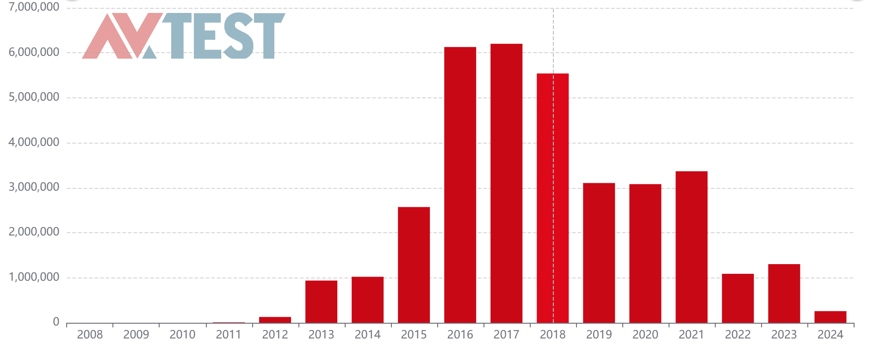
Why Android Malware ?
Malware is utilized to gain unauthorized access to systems, and steal data, disrupt system services.
According to AV-Test data, in 2024
  A total of 2,58,547 mobile malware were detected.
Source: https://www.av-test.org/en/statistics/malware/
69.44% Android market share Q4 2023 Source: https://www.bankmycell.com/blog/android-vs-apple-market-share/

Slide 3
Lecture Flow
About the dataset:
  CICAndMal2017 dataset contain 426 malware and 597 Bening App.
  Four categories: Adware, Ransomware, Scareware, SMS Malware.
  Demo with VirusTotal
Reverse Engineering of Android app.
About Androguard tool:
  Androguard is a full python tool to play with Android files.
Feature Extraction from android apk
Data Preparation
Model Training
About Genymotion emulator
  How to install
  How to create emulator
About Kivy:
  Kivy is an framework for developing Android applications using Python.
  Deploy trained model in android phone.
Deployment Procedure:
  Create layout for Android App.
    Layout contain (output box, select particular App for analysis button, and Analysis button)
  Now we got list package installed in Android emulator.
  We need to find path of Android App using package name for further analysis.
  Once Android app is found, performed analysis.

Slide 4
Thank you ?

